Slide 1
Navbar Organism

Slide 2


Navbar Molecules

Slide 3




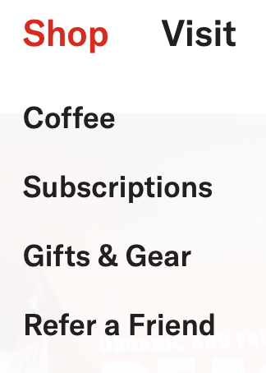

Navbar Atoms

Slide 4

Hero Organism/Molecules

Slide 5




Hero Atoms

Slide 6

Main Organism

Slide 7

Main Molecule

Slide 8

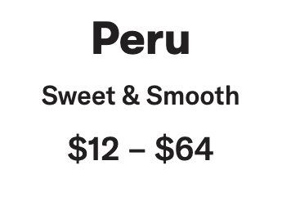
Main Atoms

Slide 9
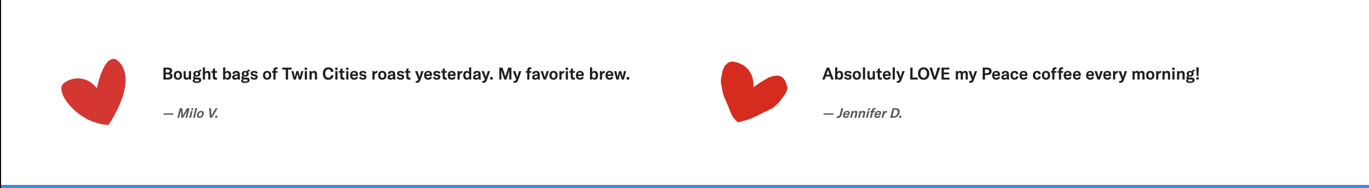
Comments

Slide 10

Social Organism

Slide 11
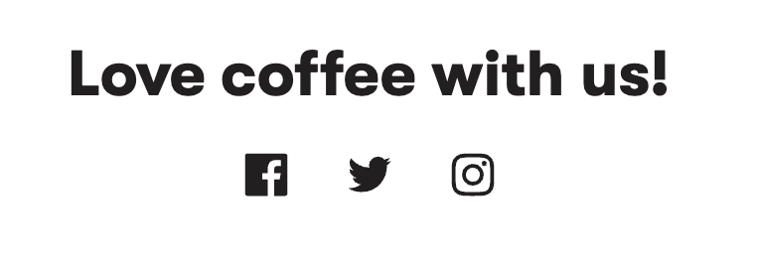





Social Molecules
Social Atoms

Slide 12



Locations Organism/Molecules

Slide 13

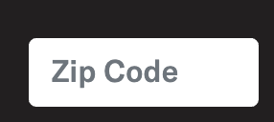





Location Atoms

Slide 14

Footer

Slide 15



Footer Molecules

Slide 16


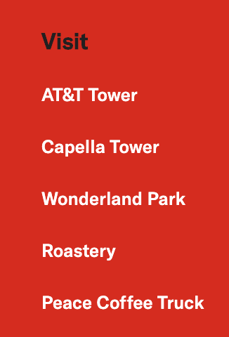







Footer Atoms

